Slide 1
Comparison of TAUW/FAO and EHPMI Approaches to Cleanup Based on Experience of Settlement #1
Petr Sharov
Environmental Health & Pollution Management Institute
Dushanbe
14 of May 2025

Slide 2
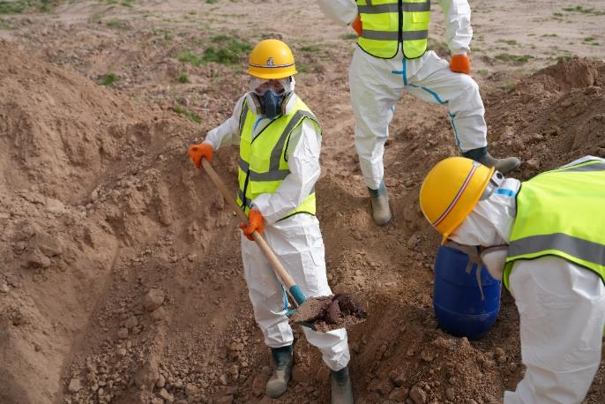
Introduction
The purpose of the presented analysis is to start a discussion and identify best approaches to assessment and cleanup of areas contaminated with POPs.
We do not pretend to know everything and hold great respect to TAUW and other expert organizations with vast practical experience in remediation of contaminated areas. We believe that exchange of experience and honest discussion will help find best solutions for future projects.

Slide 3
Differences in Assessment Approach
 | TAUW/FAO | EHPMI | Comments/ Recommendations
Samples type | Composite samples – allow confirming presence of contamination, but do not show how it is distributed. Especially in cases of uneven contamination. | Target (individual, discrete) samples – allow defining zones with different contamination levels. | Prefer more target samples in Detailed Site Assessment.
Sampling at different depths | Use of augers. Good tools and very handy in small areas. Requires time to sample. Could be difficulties if there are lots of stones in soil. In Settlement #1 the locations and sizes of two burials (in zone 4 and near the fence in zone 3) were not identified. | Use excavator to make trenches. There is a risk of mixing contamination with soil. Much less time needed for sampling at different depths in big areas. In Settlement #1 the assessment using an excavator in April 2025 allowed precise identification of all buried pesticides. | For smaller areas augers are better, for bigger areas trench excavators are preferred.

Slide 4
Differences in Assessment Approach
 | TAUW/FAO | EHPMI | Comments/ Recommendations
Mapping | Maps of very roughly defined zones of contamination and remediation strategies, not possible to see on the map where the samples were taken and what were the results of analyses | In our assessments maps clearly show the results of sampling | Maps must show the locations of samples and known concentrations in order to guide remediation activities.
Keeping sample logs | Paper based sample logs. Recorded information is similar to EHPMI protocols. | Electronic sample logs save a lot of time for recording coordinates of samples and transferring data for GIS applications and sharing. Paper logs are sometimes used as backup. | Electronic recordkeeping is preferred as more efficient.

Slide 5
Differences in Assessment Approach
 | TAUW/FAO | EHPMI | Comments/ Recommendations
Identification of sources | In Settlement #1 TAUW/FSD the investigators did not have full understanding of the sources of contamination and the history of the site because of the language barrier and lack of understanding of the pesticide migration pathways. For example, the contamination outside the site could have been influenced by the history of heavy use of DDT in the area. | Assessments and cleanups are always conducted by a team that includes both international and national specialists. | It is necessary to bring external expertise, but also make sure to build local capacity and work together with national specialists and local people. Combined teams of national and international experts are preferred.

Slide 6
Differences in Remediation Approach
 | TAUW/FAO - Planned and implemented | EHPMI – possible alternative | Comments/ Recommendations
Zones of contamination | Zone of different contamination levels defined, volumes of contaminated materials assessed, for each area and each kind of contaminated materials appropriate remediation strategies identified. Lack of coordination with national specialists on remediation strategies. | Same approach, but the remediation alternatives are usually discussed with stakeholders and national specialists. | Make sure to discuss remediation options with stakeholders, national experts, and authorities.
Zone 1 | Low level of contamination – 0.5 m layer of soil to remove and replace with clean. | We would have recommended not to remove, conduct bioremediation, monitor changes in contamination level. Later cover with a layer of clean soil. Same level of risk reduction would have been achieved. | Removal of soil was very costly and possibly unnecessary. The costs of excavation, loading, transportation, construction of special cells were very high.

Slide 7
Differences in Remediation Approach
 | TAUW/FAO - Planned and implemented | EHPMI – possible alternative | Comments/ Recommendations
Zone 2 | Remove contaminated walls and concrete foundation. The volumes of contaminated materials were assessed 250 m3, but in reality exceeded 1000 m3. By now 871 m3 removed. | Same approach, but usually we have some contingency funds to cover additional expenses if the volumes of contaminated materials exceed anticipated amounts. | Make sure to have flexibility in the project to accommodate for possible additional amounts of contaminated materials.
Zone 3 | The location and volume of the main burial were assessed adequately. Additional contaminated materials were uncovered near the fence. Pesticides were packed in special 30L drums. Highly contaminated soil sent to a special cell in Vakhsh. | Use of excavator revealed pesticides near the fence. Use of drums is a good solution. But other packaging options could have been considered. Inavailability of 30L certified drums caused a significant delay for the start of the cleanup and increased the risks for workers. | The remediation solution was correct, but the timing was not. In temperate climate remediation of DDT contamination must be implemented in the cold season.

Slide 8
Differences in Remediation Approach
 | TAUW/FAO - Planned and implemented | EHPMI – possible alternative | Comments/ Recommendations
Zone 4 | The burial was assumed to be deep and therefore it was planned to leave it as is. However Peshsaf uncovered pesticides at depth of less than 1 m and removed to Vakhsh. This required consent of FAO as it was not in the provided for in the contract. | The buried pesticides may pose a risk to people in the future. Therefore, it is better to remove pesticides to designated storages such as Vakhsh. Particularly, since in this area it is common to make deep greenhouses for growing lemons and excavate soil down to 2 meters. In such case these pesticides would have been uncovered and most likely used by local farmers. If it is not possible to remove contaminated materials, usually a layer of geotextile is placed to mark the contaminated layers. | Mistakes in detailed assessments happen. For such cases it is necessary to have flexibility in the project to accommodate for possible additional amounts of contaminated materials.

Slide 9
Differences in Remediation Approach
 | TAUW/FAO - Planned and implemented | EHPMI – possible alternative | Comments/ Recommendations
Zone 5 | The area to the south of the site was cleaned up based on findings of the old survey that used composite samples. The presumably contaminated layer of soil was replaced. | Conduct a new survey to collect individual samples in this area. Clean up only parts with high contamination that may pose high health risk. The rest of the area with lower contamination levels could be remediated using methods of bioremediation and then covered with a layer of clean soil. | The alternative solution is much cheaper. And it is more practical to clean the soil in situ rather than moving big volumes of soil to big distances without even confirming that it is all contaminated.
Zone 6 | The original plan was to remove 10 m3 of soil outside the fenced area. Based on the inspection of the area a decision was made to decrease the area to clean up. | Use bioremediation for this area and monitor concentrations using target samples every 4 or 6 months. | A detailed survey before the cleanup could show if the area needs remediation or if bioremediation is sufficient.

Slide 10
Criticism and Positive Sides
Criticism | A detailed assessment must have been conducted prior to remediation to assess any changes since the last survey, better define contaminated areas, and better assess the location and volumes of contaminated materials. | The remediation plan and costs must have been discussed with national experts, government, and stakeholders. | The remediation must have been implemented during the cold season to minimize health risks of workers from vapours and heat. It is unacceptable to schedule such remediation when the temperatures are above +30 and there are serious health risks for workers from overheating.
Positive Sides | FAO initiated remediation of a highly contaminated site that was known for many years. | FAO sent an international expert to help the remediation process and recommend necessary changes to the process. | The site was finally cleaned up and is now safe for people.

Slide 11
Conclusions
Vast experience does not guarantee that there will be no mistakes or miscalculations in assessments of contamination. It is true for TAUW, EHPMI or any other expert organization.
There should be more collaboration between organizations working on POPs in the region and particularly between international and national experts and stakeholders. International experts should help with expertise and building capacity in the country.
The cleanup in Settlement #1 was a success. However, it could have been done much sooner and at least 2 times cheaper using different approaches to assessment and remediation.

Slide 12
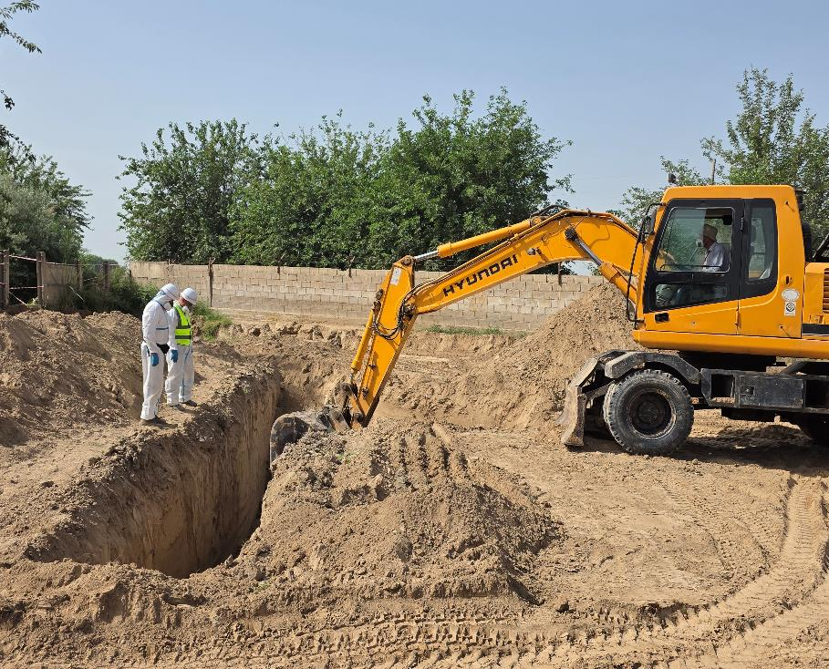
Thank you!

